Slide 1

Quantum Technologies in Defence
Presented by Sumukhi Tripathi

Slide 2
AGENDA
Introduction to Quantum Technologies
– What they are and why they matter in the modern world
Quantum Computing for Defence Applications
– Cryptanalysis, simulations, AI, and strategic advantages
Quantum Communication & Security
– Quantum Key Distribution (QKD), secure networks, and satellite-based comms
India’s Quantum Defence Initiatives
– DRDO, ISRO, NQM, and indigenous innovations
Global Landscape & Strategic Race
– Quantum efforts by China, USA, EU, and how India compares
Post-Quantum Cryptography and Cybersecurity
– Preparing for quantum threats, encryption resilience
Future Outlook
– Quantum radar, quantum internet, and battlefield deployment

Slide 3

What is Quantum Technology?
Quantum technology is a class of technology that works by using the principles of quantum mechanics (the physics of sub-atomic particles), including quantum entanglement and quantum superposition.
Quantum entanglement is when two atoms are connected, or entangled, despite being separated. If you change the properties of one of them, the other changes instantly. One possibility this creates is in enhancing the security of communication through quantum protected cipher keys. You can use entangled atoms to detect whether someone has interfered with the transmission of data
Quantum superposition is the theory that sub-atomic particles exist in multiple states simultaneously. It’s the crux of the Schrodinger’s Cat thought experiment. The practical application of this is most obvious in quantum computers. While digital computers store data as bits (the ones and zeros of binary), quantum computers use qubits that exist as a one, zero or both at the same time. This superposition state creates a practically infinite range of possibilities, allowing for incredibly fast simultaneous and parallel calculations.

Slide 4

Need of Quantum Tech in Defense
New Threat Landscape
Traditional cryptography is vulnerable to quantum attacks (e.g., Shor's algorithm can break RSA, ECC).
Adversaries can store encrypted defense data now and decrypt it later when quantum computers mature.
Faster & More Accurate Simulations
Simulating nuclear reactions, stealth materials, and radar systems with quantum precision.
Helps in faster R&D cycles for defence-grade technology.
Strategic Superiority
Nations with quantum capabilities can break enemy codes, simulate weapon systems, and optimize missions faster than ever.
Quantum-enhanced AI could dramatically improve threat detection and battlefield awareness.
Keeping Pace with Global Powers
Countries like China, USA, and EU are investing billions into quantum R&D for defence.
India must develop indigenous capabilities to ensure technological sovereignty and national security.
Need for Unbreakable Communication
Military communications must be tamper-proof and eavesdropping-resistant.
Quantum Key Distribution (QKD) offers provably secure encryption—interception is detectable by design.
Preparing for the Post-Quantum World
Adoption of Post-Quantum Cryptography (PQC) and hybrid quantum-classical networks is urgent.
DRDO’s quantum research ensures preparedness for a quantum-enabled battlefield.

Slide 5
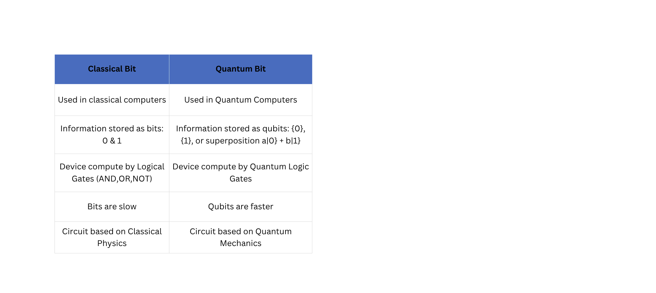
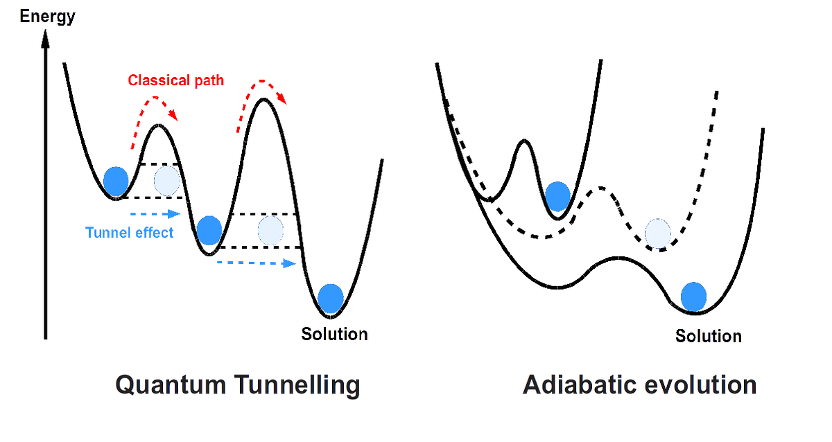
Core Concepts
Quantum annealing is a specialized type of quantum computing focused on finding the best solution (global minimum) to complex optimization problems by leveraging quantum mechanical phenomena like quantum tunneling and superposition. It differs from gate-based quantum computing by using a continuous evolution process rather than discrete logic gates.

Slide 6
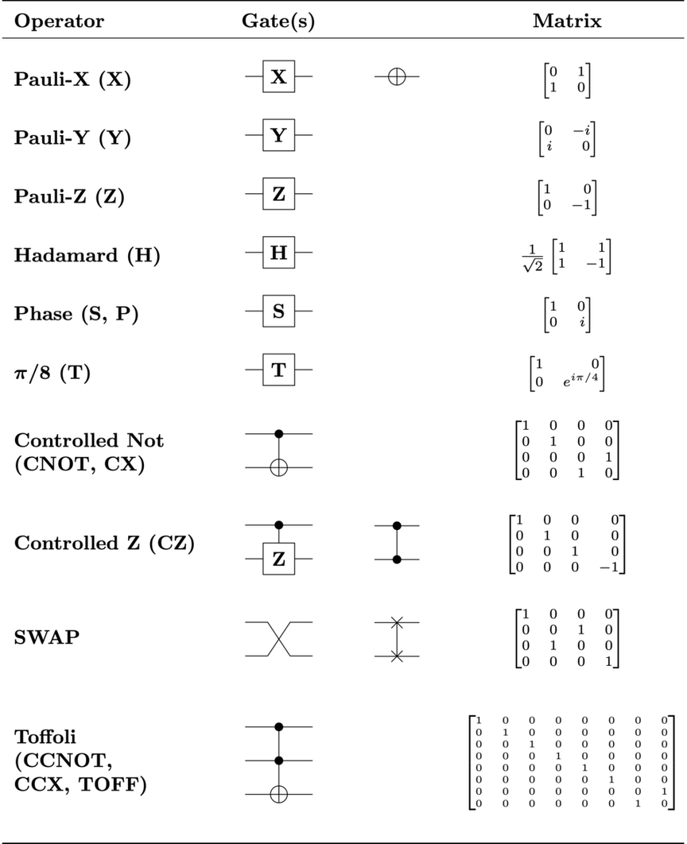
Gate-based Quantum Computing
Gate-based quantum computing is a model where quantum algorithms are implemented as sequences of quantum logic gates acting on qubits, similar to how classical logic gates are used in classical computing. These gates manipulate the quantum states of qubits, enabling computations based on superposition and entanglement.
Quantum Gates:
Quantum gates are operations that act on qubits, analogous to logic gates in classical computing. They perform unitary transformations on the quantum states of qubits. These are reversible and flexible.
Single-Qubit Gates:
Hadamard gate (H): Creates superposition.
Pauli gates (X, Y, Z): Rotate the qubit state around the X, Y, or Z axis on the Bloch sphere.
Phase gate (S, T): Introduce phase shifts to the qubit state.
Multi-Qubit Gates:
CNOT gate: A controlled-NOT gate that flips the target qubit if the control qubit is in the state |1⟩.
SWAP gate: Swaps the states of two qubits.

Slide 7
Quantum Algorithms
Shor's Algorithm:
Developed by mathematician Peter Shor in 1994. Its primary application is factoring large numbers into primes. It performs this task exponentially faster than classical algorithms, which forms the basis of current encryption methods.
Used to break RSA encryption
1
Grover's Algorithm:
Introduced by Lov Grover in 1996, provides a quantum solution to the unstructured search problem. For unsorted database it takes O(√N) time instead of O(N) time. It is advantageous in optimization tasks, such as database queries, machine learning, and pattern recognition.
2
QML Algorithms:
It combine the power of quantum computing with classical machine learning techniques like QSVM, QNN to process large datasets faster, identify patterns, and make predictions more efficiently than classical counterparts.
3

Slide 8
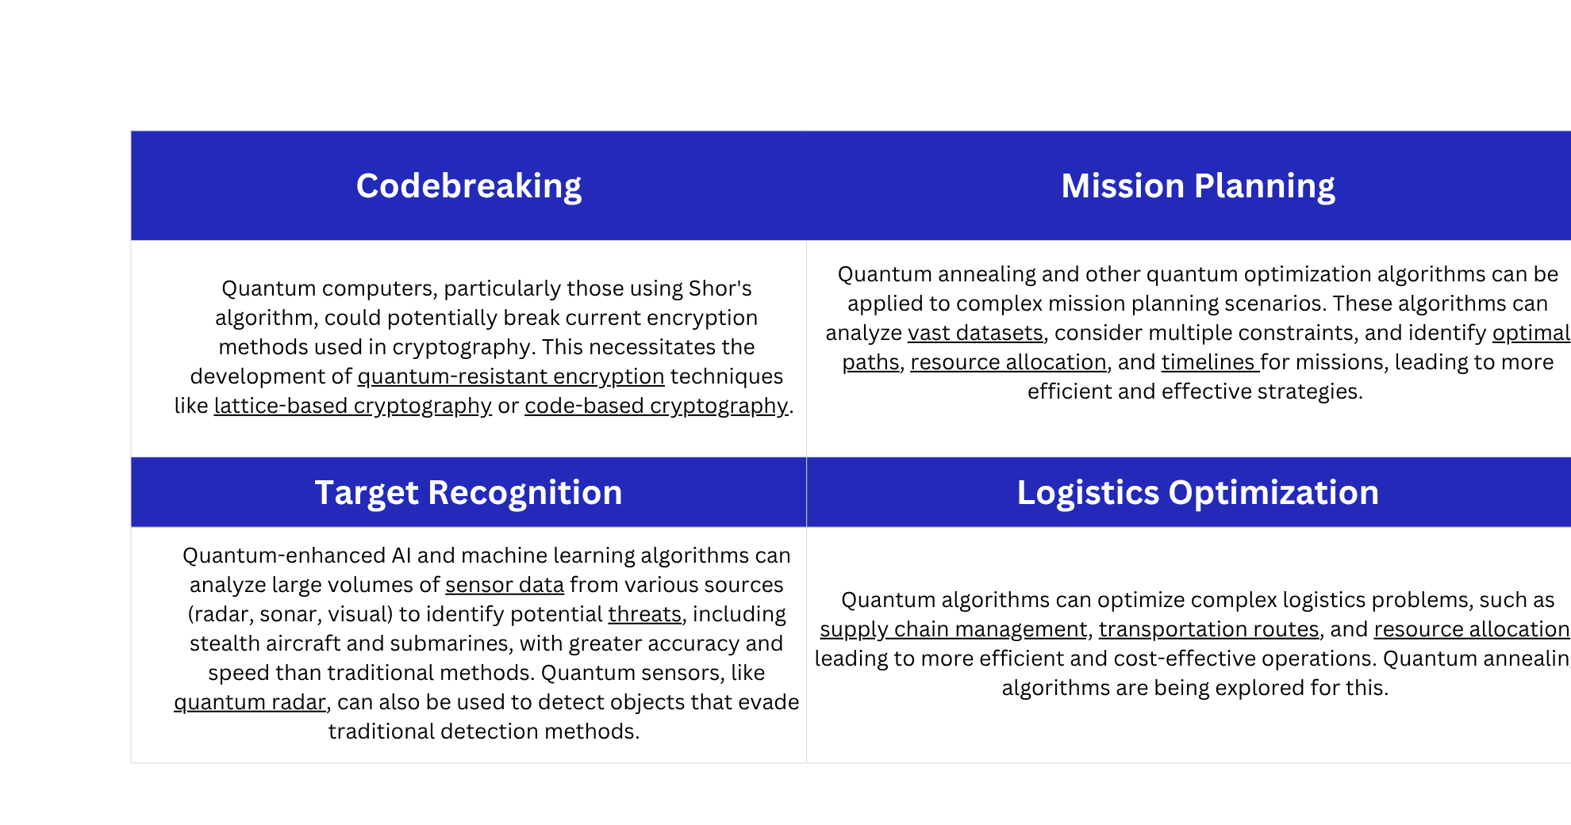
Application in Defense

Slide 9
Quantum
Simulation
Quantum simulation is using a quantum system to simulate another quantum system, often to understand or predict the behavior of complex quantum phenomena that are difficult or impossible to model with classical computers. It involves either analog quantum simulators, which are specialized systems designed to mimic specific physical systems, or digital quantum simulators, which utilize gate-based quantum computers to perform simulations.
Optimizing Military
These simulations can model complex systems — such as nuclear reactions, battlefield environments, or even global climate patterns — at an unprecedented level of detail. This capability allows military strategists to explore countless scenarios and outcomes, optimizing decision-making and strategic planning.
Quantum simulations can predict the properties of advanced materials, such as new alloys or stealth materials, before they are even created. This allows for the rapid development of materials with superior strength, durability.
Quantum simulations can model the behavior of electromagnetic waves interacting with different materials, allowing for the design of more effective stealth technologies.

Slide 10
Quantum AI in warfare
Quantum AI in warfare refers to the application of quantum computing and artificial intelligence to enhance military capabilities, potentially revolutionizing various aspects of combat and national security. This includes improving intelligence gathering, secure communication, autonomous weapon systems, and decision-making processes.
Applications in Military Operations
ISR: Quantum AI can analyze vast amounts of data from various sensors (satellites, drones, ground-based systems) to identify targets, assess threats, and provide real-time situational awareness.
Electronic Warfare: Quantum algorithms can be used to evaluate scenarios, optimize resource deployment, and develop defensive strategies in complex electronic warfare environments.
Logistics: Quantum optimization algorithms can help manage resources, plan troop movements, and optimize supply chains in dynamic and challenging battlefield conditions.
Cybersecurity: Quantum AI can be used to strengthen cybersecurity defenses by improving intrusion detection, vulnerability management, and response to cyber attacks.

Slide 11
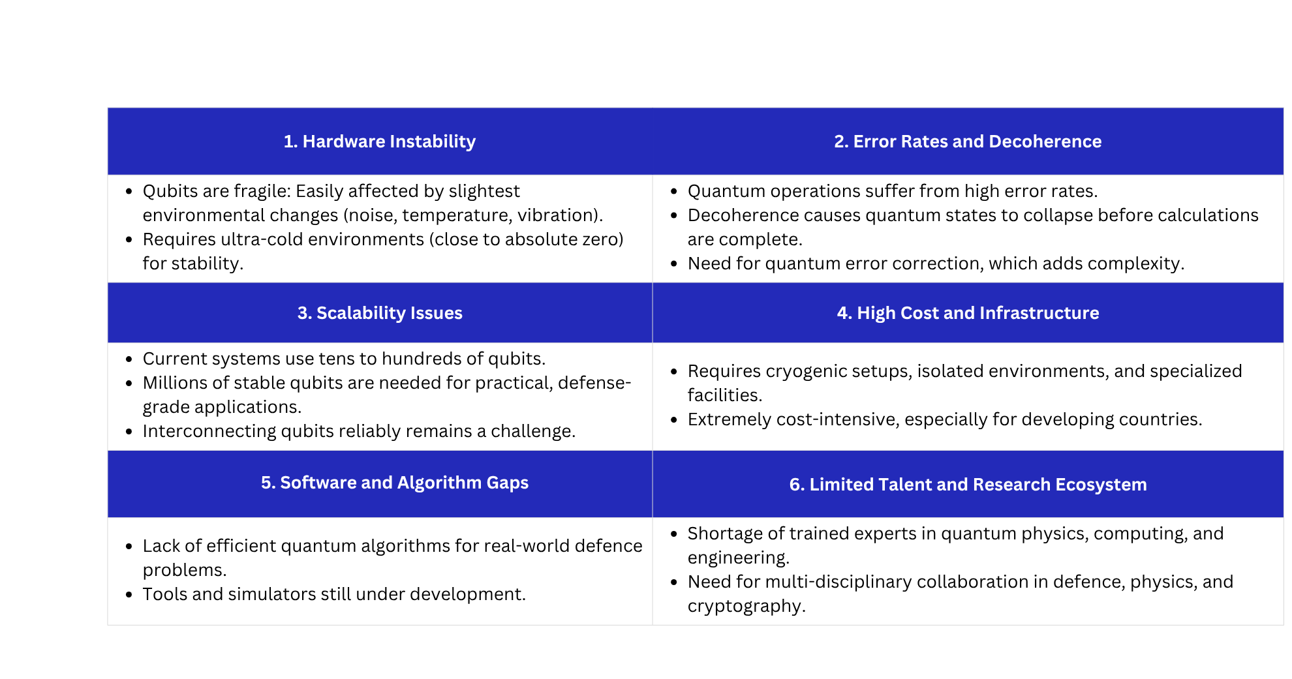
Challenges of Quantum Computing

Slide 12
What is Quantum Communication?
Quantum communication is a method of transmitting information using the principles of quantum mechanics, particularly quantum entanglement. It enables secure data transmission through protocols like quantum key distribution and quantum-state teleportation, offering a highly secure alternative to traditional encryption methods.
Quantum Key Distribution (QKD): QKD is a protocol that allows two parties to establish a shared secret key with unconditional security. It utilises the principles of quantum mechanics to detect any eavesdropping attempts, ensuring that the key remains secure. Examples: BB84 and E91.
Quantum Teleportation: Quantum teleportation is a protocol that enables the transfer of quantum states from one location to another without physically moving the particles. It relies on the entanglement of particles to transmit the quantum information instantaneously, making it useful for secure quantum communication.

Slide 13
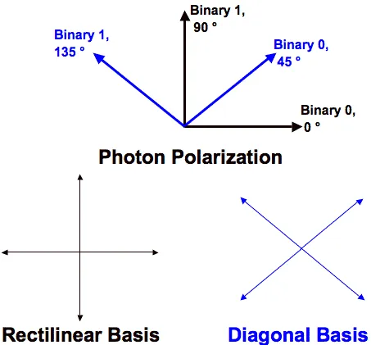
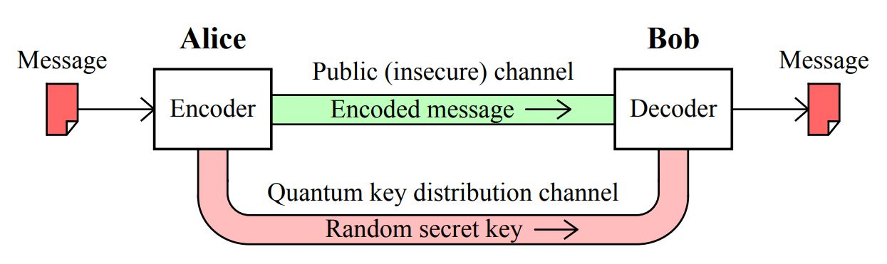
Quantum Key Distribution
QKD is a secure communication method for exchanging encryption keys only known between shared parties. It uses properties found in quantum physics to exchange cryptographic keys in such a way that is provable and guarantees security. It enables two parties to produce and share a key that is used to encrypt and decrypt messages.
In the BB84 protocol, Alice can transmit a random secret key to Bob by sending a string of photons with the private key encoded in their polarization. The no-cloning theorem guarantees that Eve cannot measure these photons and transmit them to Bob without disturbing the photon’s state in a detectable way.
The above is true, considering no error on the quantum channel. If the track is prone to error, Alice and Bob will not detect Eve’s presence all the time.

Slide 14
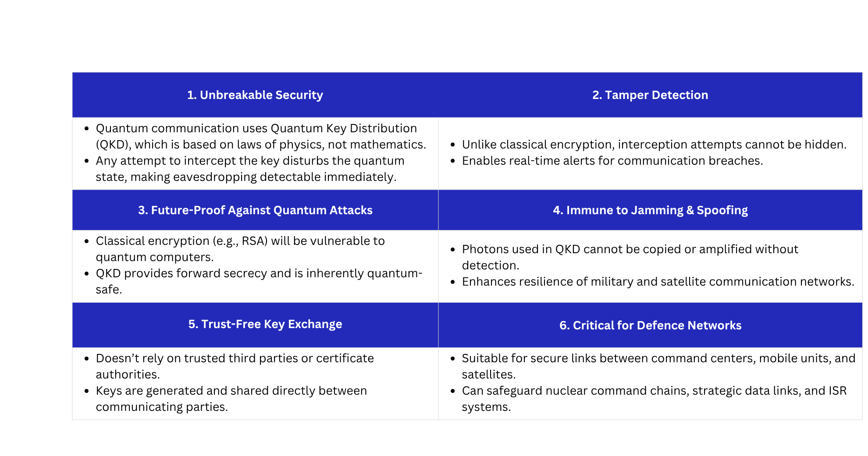
Advantages over classical communication

Slide 15
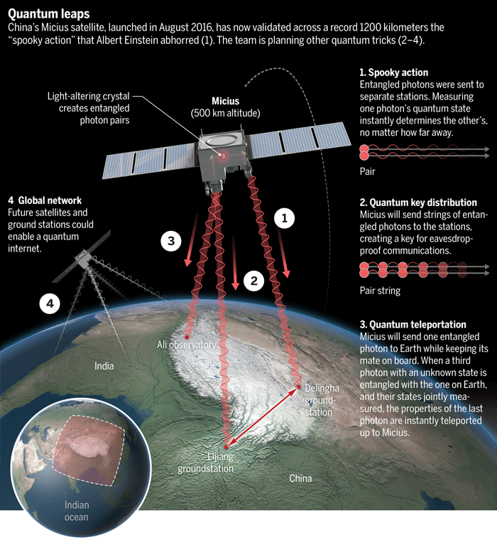
Satellite-based QKD
Satellite-based (QKD) enables secure,
long-distance communication by using
satellites to transmit encryption keys,
leveraging the principles of quantum mechanics
for enhanced security.
This technology addresses the limitations of ground-based systems, like signal degradation in optical fibers, by utilizing free-space communication through space.
Key Developments:
China's Micius Satellite: Launched in 2016, Micius is the first quantum communication satellite, enabling long-distance quantum key distribution and entanglement-based experiments.
Indian Developments:
National Quantum Mission: India is investing significantly in quantum technologies, including satellite-based QKD, under the National Quantum Mission.
QKD Demonstrations:
Free-space quantum communication over 300 meters by ISRO.
QKD over a 1km distance using entanglement in the air by IIT-Delhi.
QKD transmission over a 4-core Multi-Core Fibre by C-DOT and STL.

Slide 16
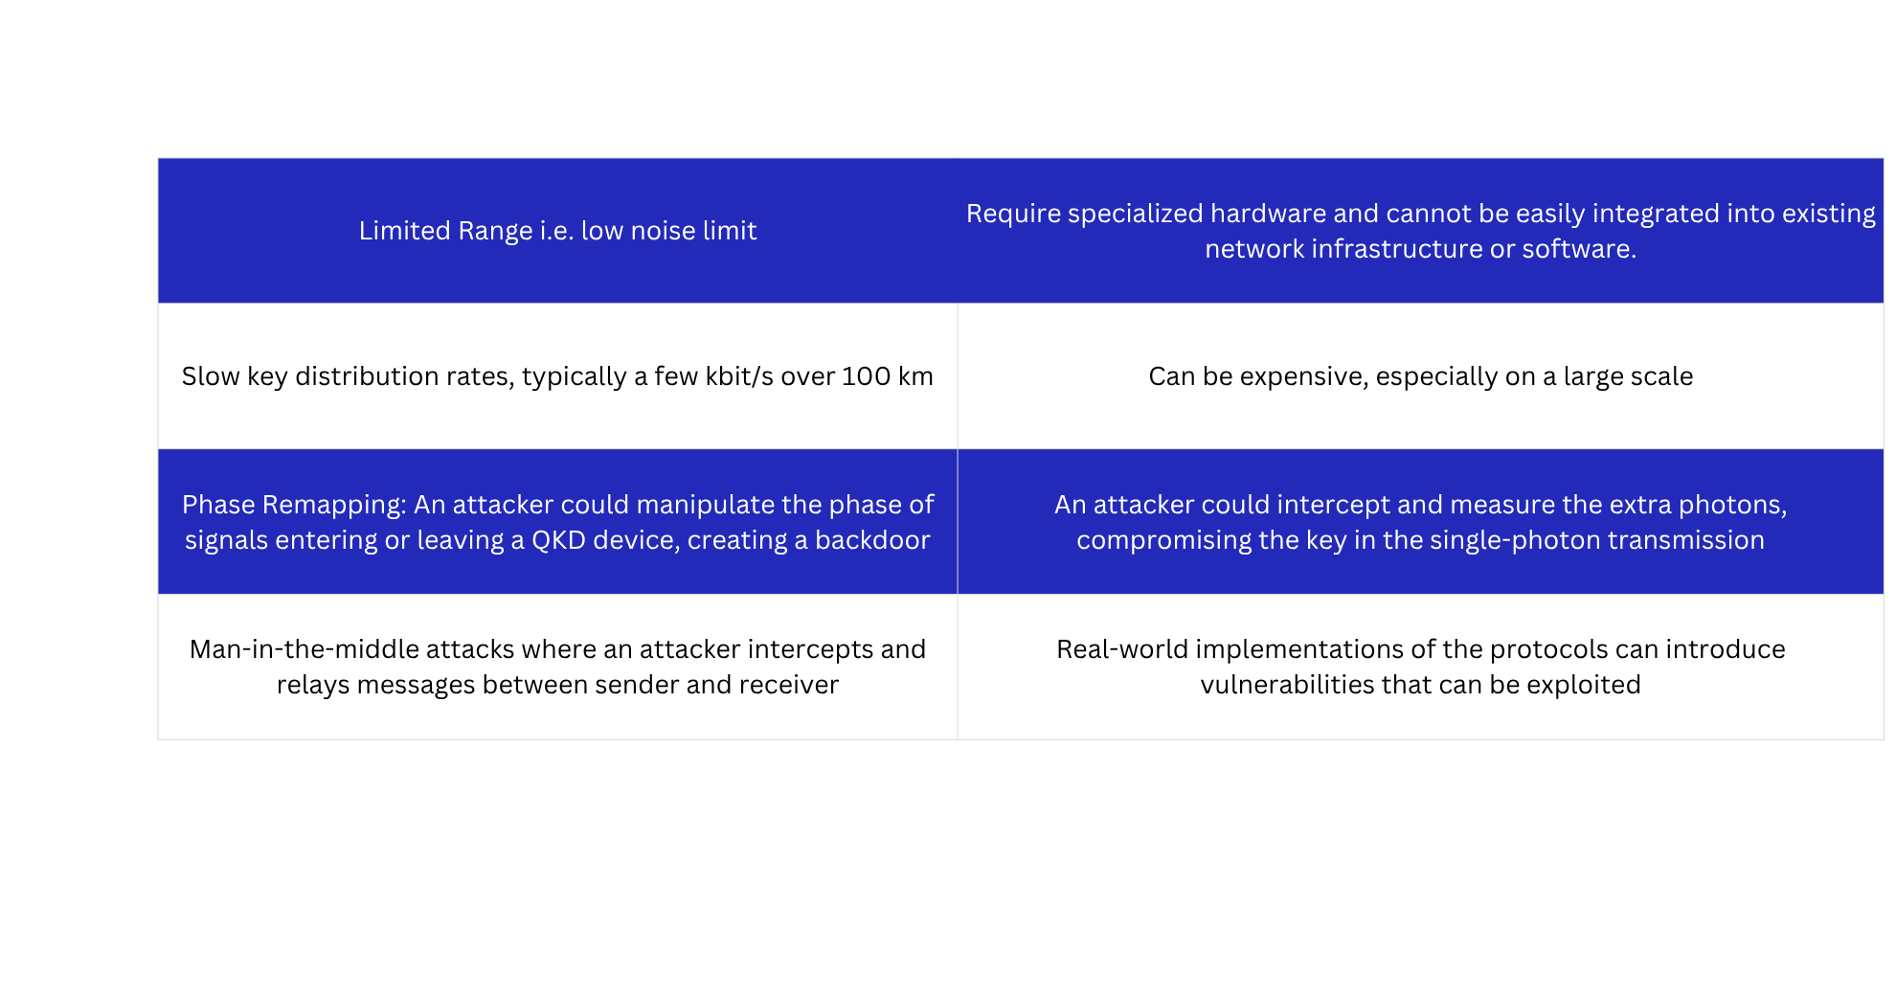
Limitations
and Threats

Slide 17
India’s Role in Quantum Defence

Slide 18
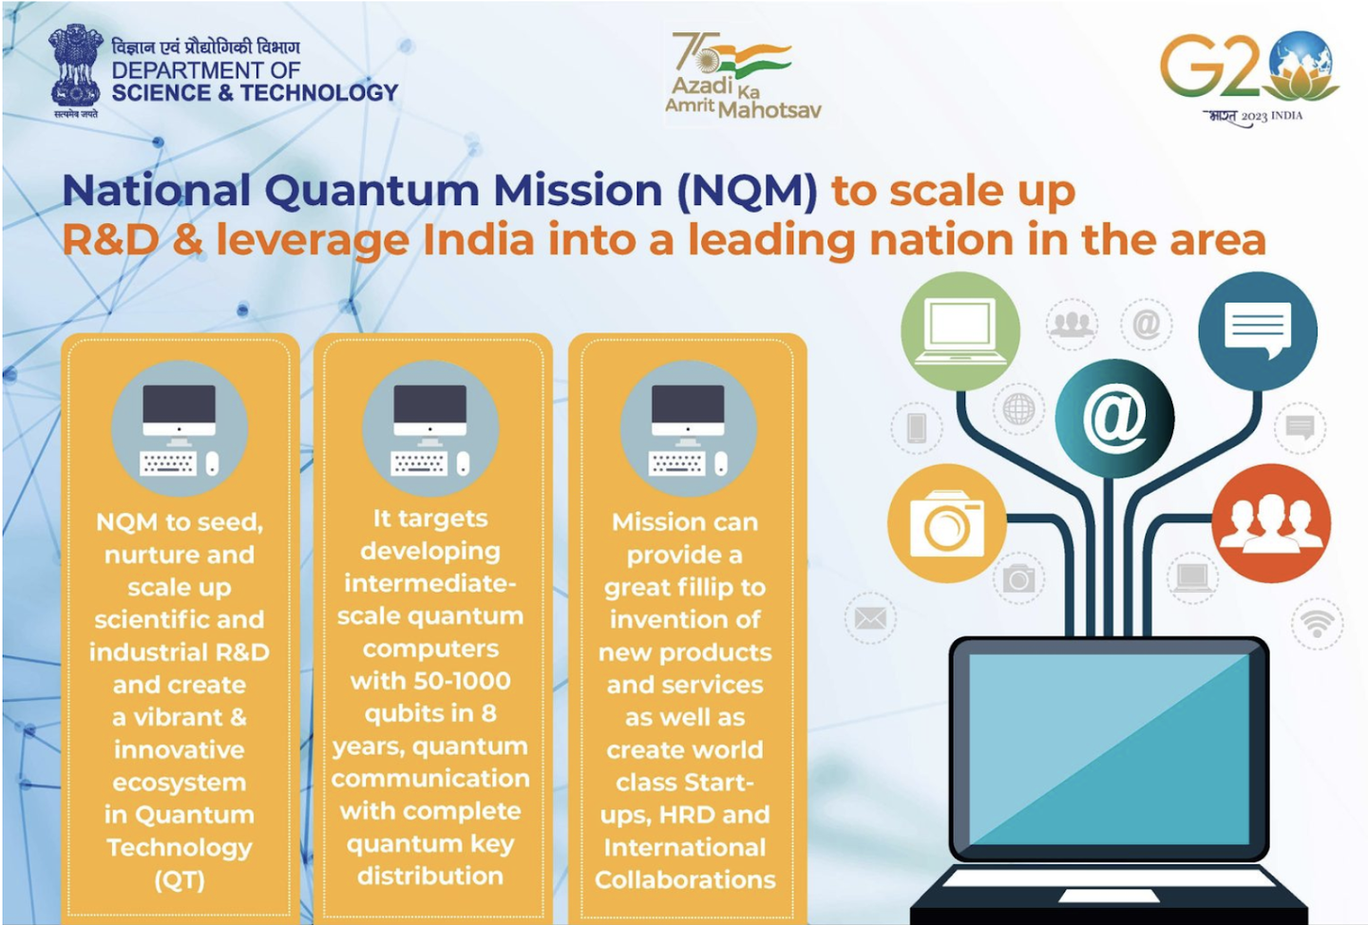
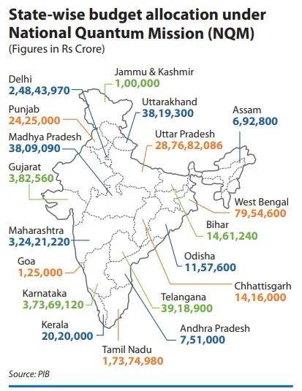
Goverment Initiatives

Slide 19
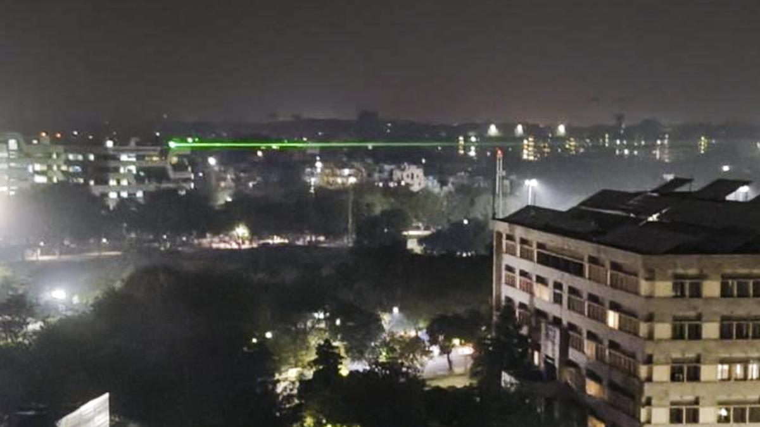
DRDO Contributions
DRDO is actively involved in field testing (QKD) technologies, particularly between Secunderabad and Hyderabad, and is also establishing Centres of Excellence (CoEs) within IITs. These initiatives are part of a broader effort to advance secure communication technologies for defense applications.
DRDO has successfully demonstrated QKD technology, including a 12km link between two Hyderabad-based labs (DRDL and RCI). Additionally, they have collaborated with IIT Delhi to establish a QKD link between Vindhyachal and Prayagraj, using both fiber optic and free-space methods. [*]

Slide 20

ISRO’s Contributions
ISRO's role in quantum communication satellite trials is focused on developing and demonstrating the technology for secure, satellite-based quantum communication. This includes developing key technologies like robust entangled photon sources, quantum key distribution (QKD) protocols, and secure cryptographic software. ISRO aims to use these technologies for future-proof data security and to establish India as a leader in quantum communication.
ISRO has demonstrated free-space quantum communication over a distance of 300 meters. It was demonstrated at Space Applications Centre (SAC), Ahmedabad, between two line-of-sight buildings within the campus. The experiment was performed at night, in order to ensure that there is no interference of the direct sunlight.
The experiment is a major breakthrough towards ISRO’s goal of demonstrating Satellite Based Quantum Communication (SBQC), where ISRO is gearing up to demonstrate the technology between two Indian ground stations.

Slide 21

Startups & Academia
QNu Labs – India’s First Quantum Security Startup
Bengaluru-based startup working on quantum-safe communication solutions.
Developed Tropos (QKD product) and Armos (quantum random number generator).
Collaborating with DRDO and defence organizations for secure quantum communication.
Received support from iDEX (Innovations for Defence Excellence).
Academic Institutions Driving Research
🔹 IIT Madras
Hosts a Centre of Excellence in Quantum Information, Communication, and Computing.
Partners with DRDO on quantum memory and teleportation research.
🔹 IISc Bangalore
Pioneering work in quantum information theory, quantum machine learning.
DRDO collaboration on quantum cryptography protocols.
🔹 IIT Bombay, IIT Delhi, TIFR, RRI
Research in quantum optics, qubit stability, and quantum materials.
Engage in joint projects under National Quantum Mission (NQM).
National Collaboration Framework
DRDO, MeitY, DST, and ISRO promoting academia–industry–government collaboration.
Quantum-enabled testbeds being developed at IITs for military-grade experimentation.

Slide 22
Global Quantum Race
China
Quantum Satellite: China launched the world's first quantum science satellite, Micius, in 2016. This satellite enables secure quantum communication over vast distances, including transmissions between Asia and Europe.
Quantum Backbone Network: China has also built a 2,000 km terrestrial quantum network connecting major cities like Beijing and Shanghai. This network utilizes fiber optics for quantum key distribution.
Global Implications: These advancements demonstrate the potential for building a global quantum internet and securing communications across continents. China's work in this area has spurred international collaboration, including with South Africa.
Future Plans: China intends to launch more quantum satellites to expand geographical coverage and establish a global quantum communication service by 2027.

Slide 23
USA
DARPA's Quantum Benchmarking Initiative (QBI): It aims to develop rigorous performance metrics and enable the design of practical, useful quantum computers for national and global challenges by 2033. It also includes an Independent Verification and Validation (IV&V) component to ensure unbiased assessment of quantum computing approaches.
IBM's Quantum Efforts: It is working to implement post-quantum encryption to enable quantum-safe Transport Layer Security (TLS). This involves extending quantum-safe security from the client interface to the cloud services layer and beyond. It is also involved in PQC initiatives.
NSA's Post-Quantum Cryptography Efforts: It views post-quantum cryptography as a more cost-effective and easily maintained solution than quantum key distribution (QKD). It has announced selections for quantum-resistant algorithms and provides guidance on post-quantum cryptography through documents like CNSS Policy 15 and the FAQ for the Commercial National Security Algorithm (CNSA) Suite 2.0.
EU and NATO
Quantum Key Distribution (QKD): EuroQCI will leverage QKD technology to securely distribute encryption keys, enhancing the security of communication channels.
Post-Quantum Cryptography (PQC): Recognizing that classical encryption methods are vulnerable to future quantum computers, EuroQCI is actively involved in the standardization of PQC algorithms, which are designed to be secure against both classical and quantum attacks.
European Collaboration: The project involves all 27 EU Member States and is being developed with the support of the European Commission, European Space Agency (ESA), and other relevant bodies.
Standardization: EuroQCI is working towards establishing standards for QKD-based technologies and services, ensuring interoperability and security across different implementations.
Testing and Validation: A dedicated testing and validation infrastructure is being developed to assess the performance and security of various QKD technologies and ensure their compliance with established standards.
National and Space-Based Components: The EuroQCI will have both terrestrial (fiber-optic) and space-based (satellite) components to ensure broad coverage and resilience.

Slide 24
Post Quantum Cybersecurity
Post-Quantum Cryptography (PQC) is a branch of cryptography that aims to develop algorithms and protocols capable of withstanding the computational power of quantum computers. Quantum computers utilize the principles of quantum mechanics to perform certain types of calculations at unprecedented speeds that are unattainable by classical computers.
The urgency for PQC arises from the potential of quantum computers to break widely-used cryptographic algorithms like RSA (Rivest-Shamir-Adleman), ECC (Elliptic Curve Cryptography), and DSA (Digital Signature Algorithm).
NIST's Role: The National Institute of Standards and Technology (NIST) initiated a standardization process for PQC in 2016, recognizing the potential threat of quantum computers. The goal was to identify and standardize algorithms that could replace or supplement existing public-key cryptography to ensure long-term security.
The First Three PQC Standards:
ML-KEM (based on Crystals-Kyber): An encryption/KEM (Key Encapsulation Mechanism) standard.
ML-DSA (based on Crystals-Dilithium): A signature scheme standard.
FALCON: Another signature scheme standard.
SPHINCS+: A stateless hash-based digital signature standard, standardized in FIPS 205.
These standards are widely adopted and are important for future-proofing, long term security and transition to quantum-safe systems.

Slide 25
“Harvest Now, Decrypt Later”
A “harvest-now, decrypt-later” attack is a strategy in which a threat actor simply collects and stores encrypted data today with the intent of decrypting it with a sufficiently powerful quantum computer (when it is available) in the future. Experts believe that these attacks are mainly being carried out by nation-state actors, targeting sensitive information that remains valuable over time, such as government secrets, bank account information, healthcare records, personally identifiable information (PII), and corporate intellectual property.
The driving force behind these attacks is quantum computing’s potential to break today’s widely used public-key encryption algorithms. Virtually all of today’s secure Internet traffic, email communications, databases, and software are protected by encryption algorithms like RSA, ECC, and Diffie-Hellman which are currently secure because cracking them would take many, many years for even the most powerful supercomputers available today. However, with its unparalleled processing power, a CRQC (Cryptographically Relevant Quantum Computer) will be able to break these encryption methods using algorithms like Shor’s in a matter of seconds or minutes.
The history of cyberattacks, including the ones on Adobe (2013), Sony (2014), Equifax (2017), Marriott (2018), SolarWinds (2020), and Colonial Pipeline (2021), have made it clear that no sector is immune to cyberattacks. Threat actors are increasingly focusing on corporate intellectual property (IP) and critical enterprise data.
What makes enterprise businesses particularly vulnerable to HNDL attacks is the long-term value of their data. Sensitive customer information, proprietary research, and intellectual property can remain relevant and valuable for decades. If this data is harvested today, the damage caused by its exposure—even many years later—could be catastrophic. After all, data is the new gold!

Slide 26
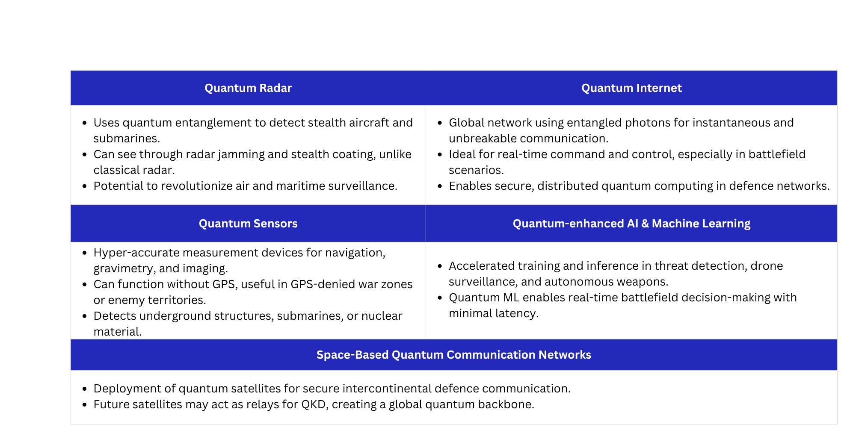
Future Innovations

Slide 27
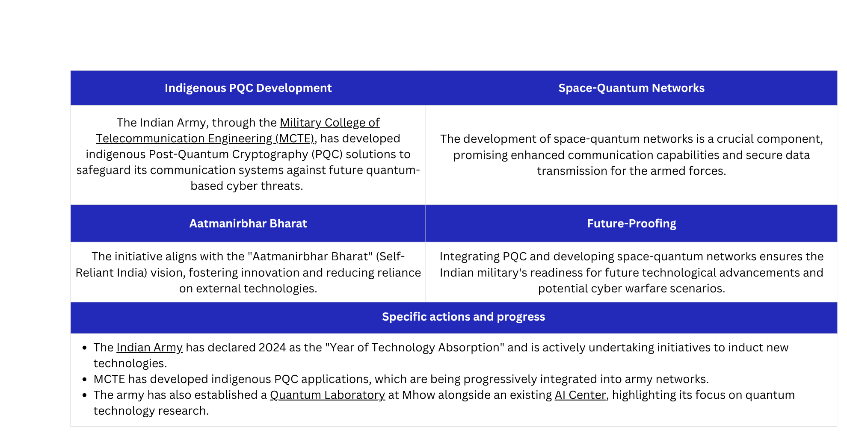
Vision for Indian Defense

Slide 28
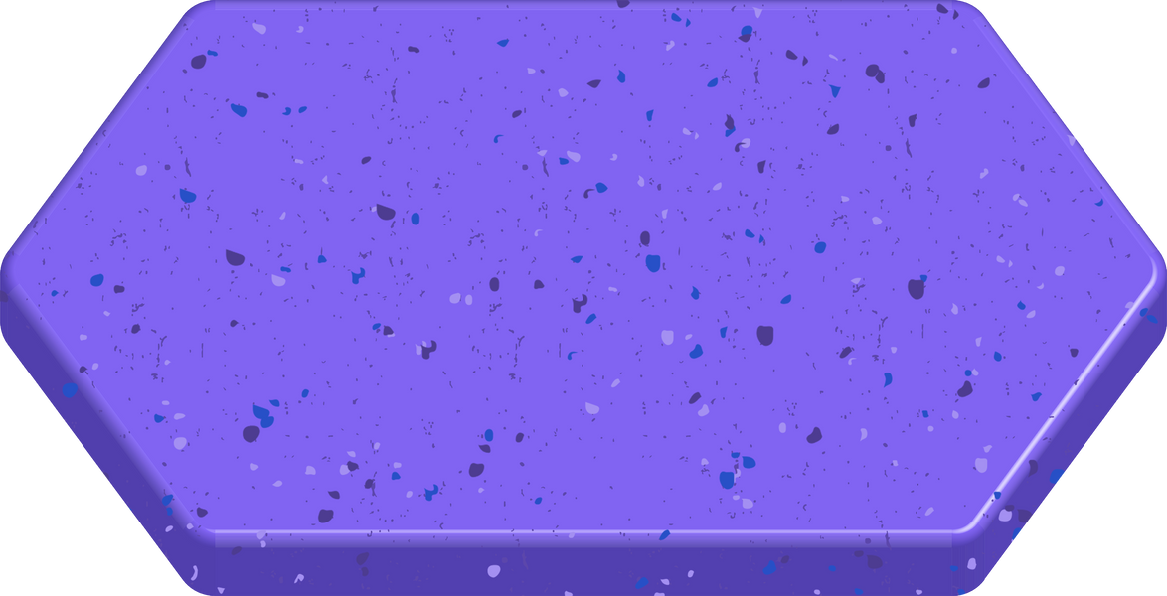
Summary
Quantum Computing: A Strategic Asset
Can break traditional encryption, simulate weapons and optimize military operations.
Offers superior decision-making capabilities through quantum-enhanced AI.
India’s Growing Quantum Ecosystem
DRDO, ISRO, and startups like QNu Labs are driving quantum innovation.
National Quantum Mission and academic collaborations are laying a strong foundation.
Defence Must Be Quantum-Ready
Post-Quantum Cryptography is essential to protect defence data before adversaries gain quantum advantage.
Future innovations like quantum radar, sensors, and quantum internet will redefine warfare.
Quantum Communication: Future of Secure Defence Networks
Enables unbreakable, tamper-evident communication using QKD.
Critical for command & control, space communication, and secure battlefield links.
The Global Race is On
Countries like China, USA, and EU are heavily investing in quantum supremacy.
India must act fast to maintain strategic parity and tech sovereignty.

Slide 29
Reference & Resources
https://quantum-computing.ibm.com/
https://www.paconsulting.com/insights/what-is-quantum-technology
https://arxiv.org/list/quant-ph/recent
https://www.spinquanta.com/news-detail/quantum-computer-algorithms
https://www.niti.gov.in/sites/default/files/2025-03/Future-Front-Quarterly-Frontier-Tech-Insights-March-2025.pdf
https://medium.com/aardvark-infinity/quantum-computing-in-military-technology-revolutionizing-defense-with-physics-and-math-a2d36591a3f0
https://research.csiro.au/quantumbattery/research/quantum-communications/
https://medium.com/quantum-untangled/quantum-key-distribution-and-bb84-protocol-6f03cc6263c5
https://www.pib.gov.in/indexd.aspx
https://www.qnulabs.com/
https://csrc.nist.gov/projects/post-quantum-cryptography
https://www.appviewx.com/blogs/what-you-need-to-know-about-harvest-now-decrypt-later-attacks/

